Slide 1
Capstone Project:- Pneumonia Detection Challenge
Project Group:- 1. Asim Nadaf
2. Akshay RamChandra
3. Animesh Sharma

Slide 2
Agenda
What is Pneumonia, CXR Visibility & Lung Opacities
Opacities that are not related to Pneumonia
Pre-Processing, Data Visualization, EDA
Exploring the given Data files, classes and images of different classes.
Dealing with missing values
Visualization of different classes
Analysis from the visualization of different classes.

Slide 3
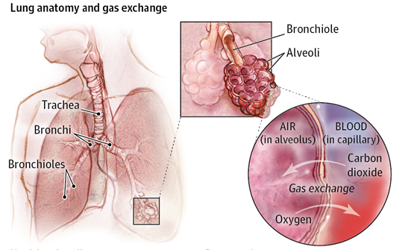
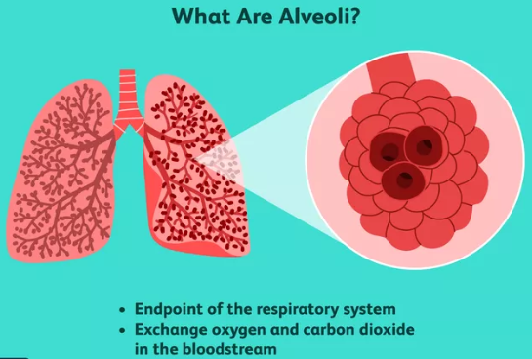
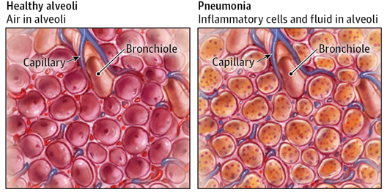
What is Pneumonia?
Pneumonia is an infection in one or both lungs. Bacteria, viruses, and fungi cause it.
The infection causes inflammation in the air sacs in your lungs, which are called alveoli.

Slide 4
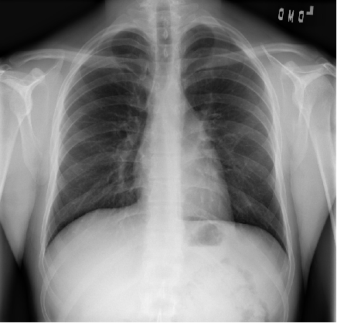
CXR Visibility
Tissues with sparse material, such as lungs which are full of air, do not absorb the X-rays and appear black in the image.
Dense tissues such as bones absorb X-rays and appear white in the image.
Black = Air
White = Bone
Grey = Tissue or Fluid
Normal Image

Slide 5
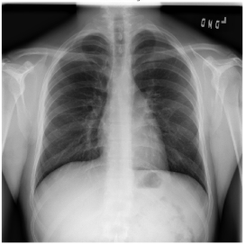
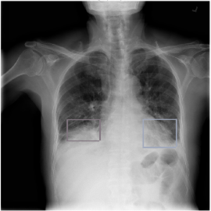
Lung Opacities
Pneumonia usually manifests as an area or areas of increased opacity on CXR.
Normal vs. Lung Opacity images
Normal Image
Lung Opacity

Slide 6
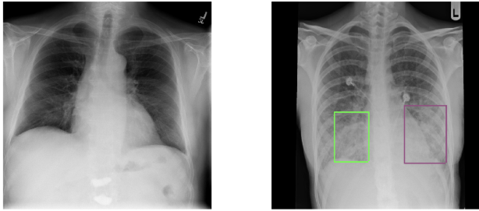
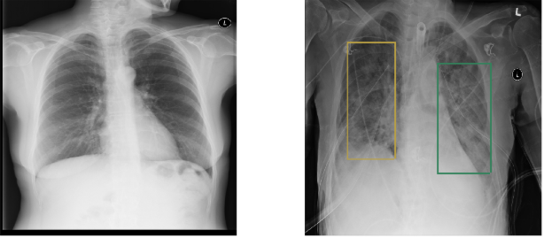
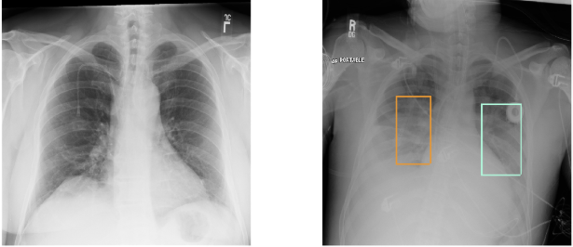
Lung Opacities
Normal Image
Lung Opacity

Slide 7
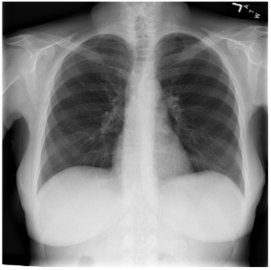
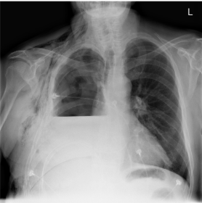
Opacities that are not related to Pneumonia
1. Pleural effusion
Normal Image
Pleural Effusion
The lower part of the right lung of Pleural Effusion image (the right lung is at the left side of the picture) is shorter than in a Normal image.
It is caused by an accumulation of fluid in the chest outside of the lung. This causes the lung to look smaller on the chest radiograph.

Slide 8
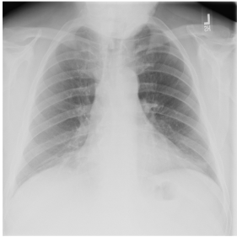
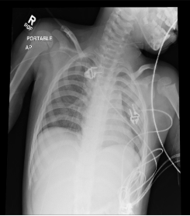
Opacities that are not related to Pneumonia
2. Unclear Abnormality
We can't see a clear reason for this image to be abnormal.
This is a low quality chest radiograph.
The left lung (on the right side of the picture) looks small but that's because the image is not symmetrical.

Slide 9
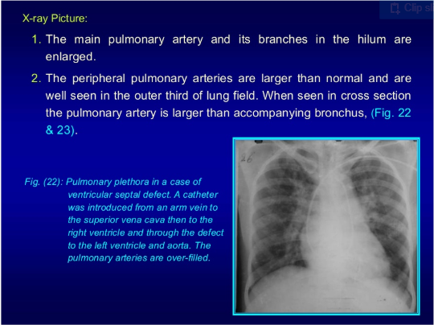
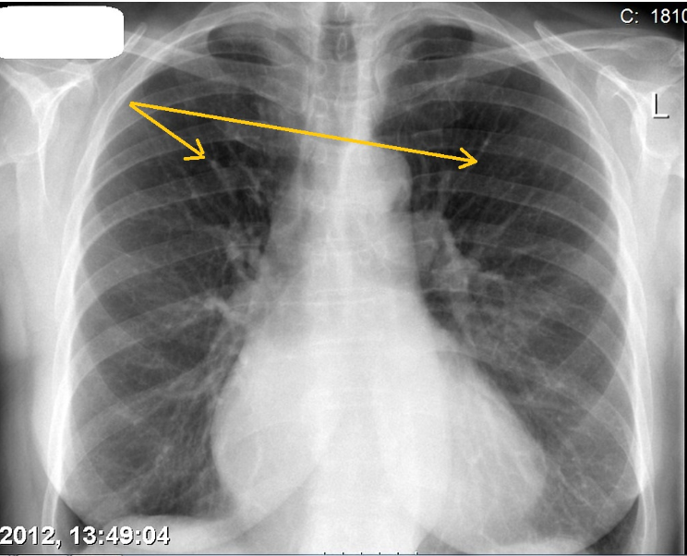
Opacities that are not related to Pneumonia
3. Pulmonary Edema
Cephalization refers to the redistribution of blood into the upper lobe vessels.
Pulmonary venous pressure exceeds 10 to 12 mmHg results in cephalization.

Slide 10
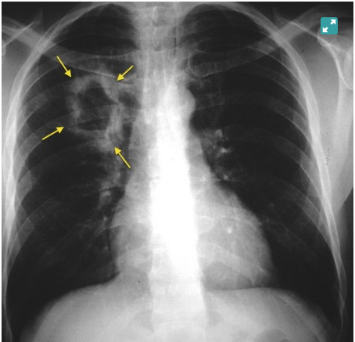
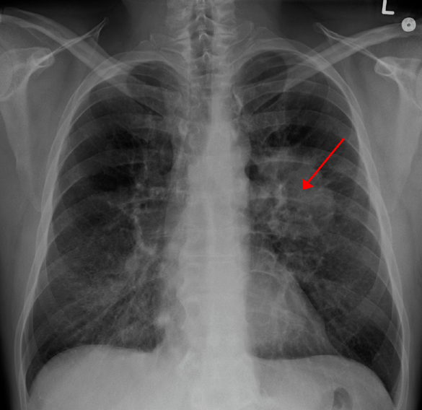
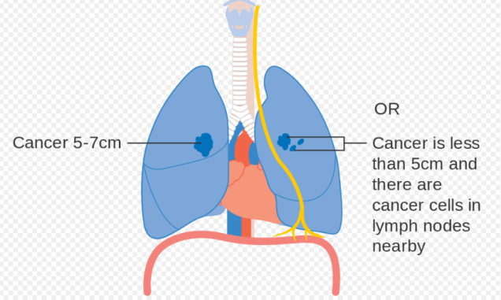
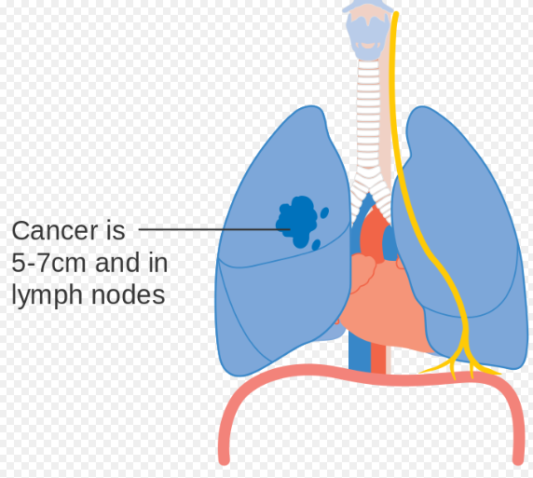
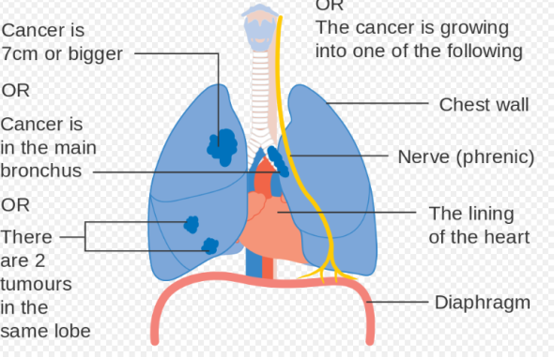
Opacities that are not related to Pneumonia
4. Lung Cancer
Lung Cancer is a malignant lung tumor characterized by uncontrolled cellgrowth in tissues of the lung.

Slide 11
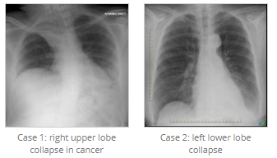
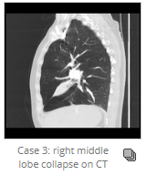
Opacities that are not related to Pneumonia
5. Volume loss (Atelectasis or collapse)
Atelectasis describes loss of lung volume secondary to collapse.
It has many causes, the root of which is bronchial obstruction with absorption of distal gas.
Atelectasis may be sub segmental, segmental, lobar, or involve the entire lung.

Slide 12
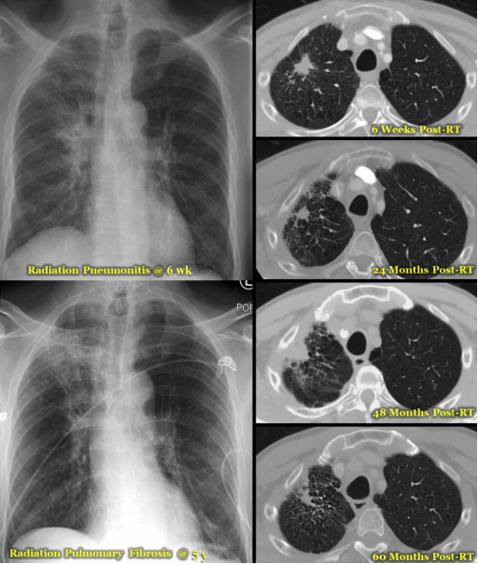
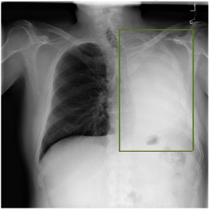
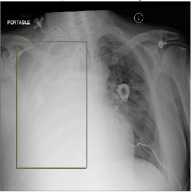
Opacities that are not related to Pneumonia
5. Post radiation or Surgical changes
Radiation-induced lung injury (RILI) encompasses any lung toxicity induced by radiation therapy (RT) and manifests acutely as radiation pneumonitis and chronically as radiation pulmonary fibrosis.

